Slide 1


Cloud for AI
Lecture 1: Hello!
Filotas Theodosiou

Slide 2

Personal Details
My name is Filotas Theodosiou.
Data Scientist - AI Researcher with a Bachelor in Mathematics
Member of the Belgium Forecasting Center
Member of the International Symposium of Forecasting
Contact Details:
filotas.theodosiou@vives.be
Feel free to contact me for anything ML related at any time.

Slide 3
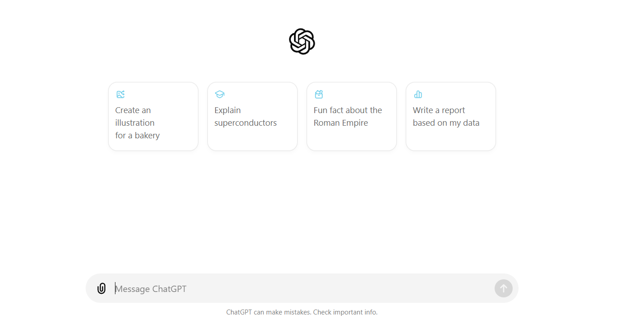
Notes:
I am pretty sure you have seen this before. You are using that for a number of reasons.
What if I tell you that by the end of the course you will be able to make something like that in 40 lines of code?

Slide 4
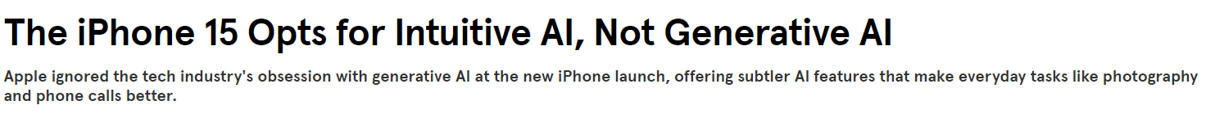

Som iPhone 15 novel ML features:
Detect humans/pets on cameras & switch to portrait mode
Incorporate 25% improved Siri to all applications
Voice isolation cuts noise for better call quality
How are these features added?
Notes:
Most of you might have heard the hype arond LLMs etc.
However this is not what ML is all about
This is a good example
So Apple follows a different approach to generative AI and LLMs
Instead they deliver ML on most of their applications to enhance the user experience
Read the examples
The question is, how are these features incorporated in the phones? Thats what the course is about!

Slide 5
2024: ML is in almost every aspect of our lives
Machine Translation
Photo editing
Face
unlocking
Recommendation
Fraud detection
ETA
Search
Self driving cars
AI assistant
Smart compose
Smart security cameras
Notes:
All right ML nowadays is almost everywhere.
You hear about advances in chatGPT and LLMs
but keep in mind that ML applications are almost everywhere
(read some examples)

Slide 6
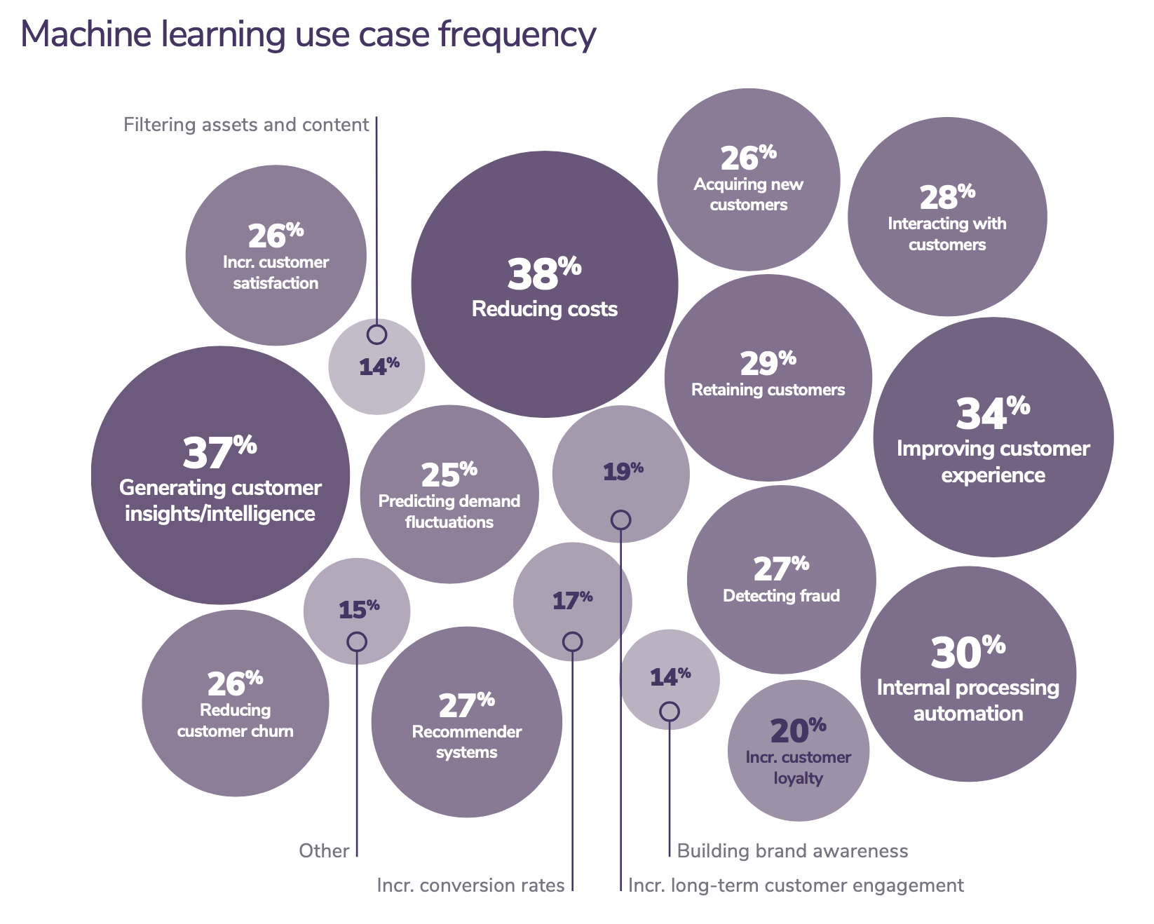
Real-world Machine Learning: The Impact of AI
2020 state of enterprise machine learning by Algorithmia
Notes:
How is AI implemented in real life? Lets look at some examples
For of all it reduces costtsts, better accuracy, better predictions, better performance
Retaining costumers either by good recommendations or by identifying who is going to leave pretty early
Fraud, interactions and more

Slide 7
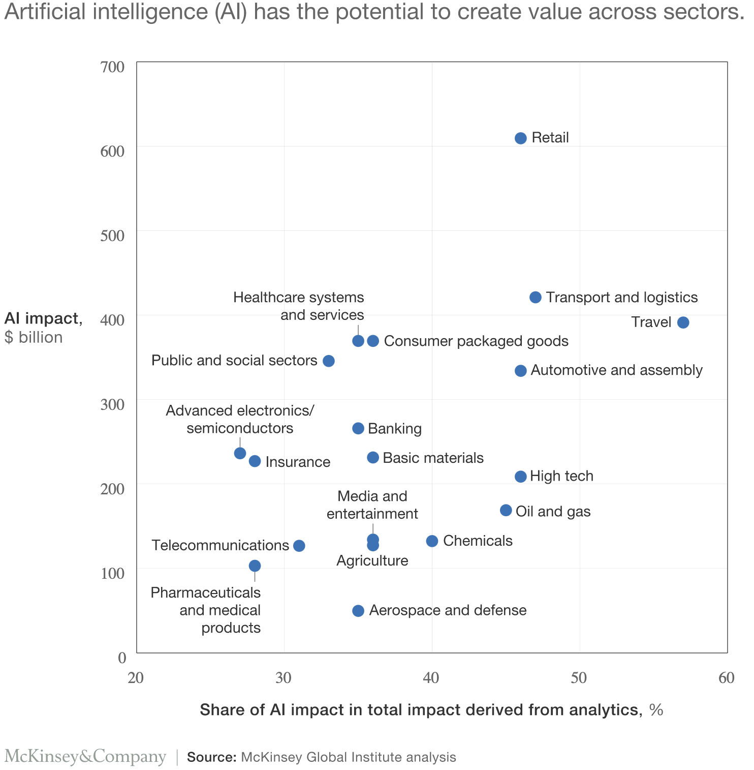
AI value creation by 2030
13 trillion USD
Most of it will be outside the consumer internet industry
Notes:
Lets try to understand the impact of ML in industry
It is projected that AI will create 13 billion dollar in revenue
Coming from different sectors
(talk some examples)

Slide 8
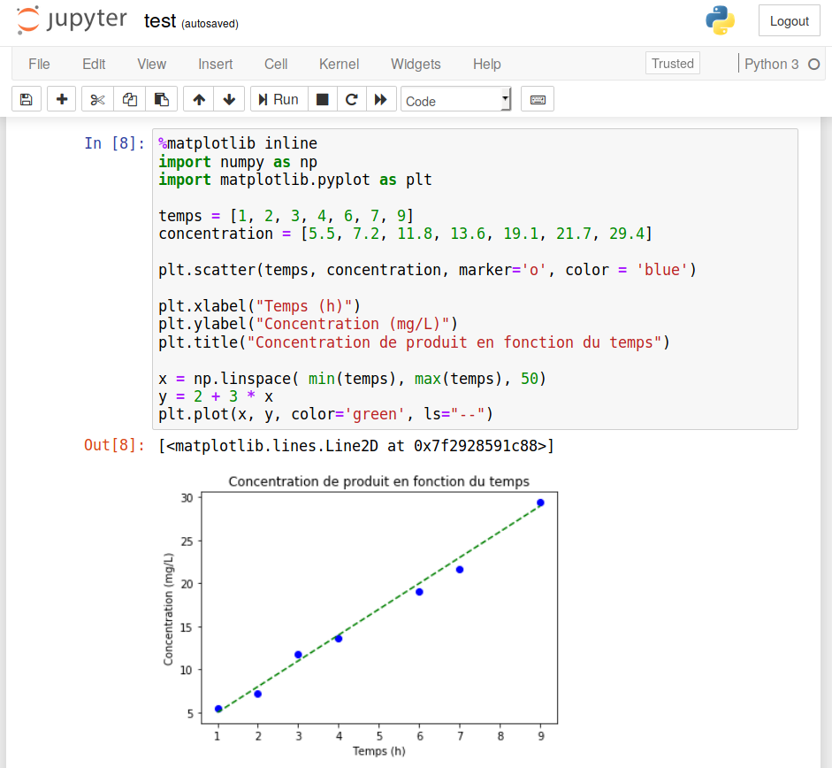
No more Jupyter Notebooks or Excel Files
Notes:
Maybe you are familiar with these. The basic tool of every data scientist.

Slide 9
No more Jupyter Notebooks or Excel Files
A Machine Learning System is much (much) more than some code on a Jupyter Notebook
Notes:
As useful as it might be and as I love it, the impact of AI and ML is not through jupyter notebooks.
Unfortunately that would be great!

Slide 10
Why ML Systems Design?
ML algorithms is the less problematic part
The hard part is to make algorithms work with other parts in order to solve real-world problems
Most failures in real-world applications are caused by non-ML components
Notes:
take for example an app on your phone.
you click somewhere
some features are created
these are passed to another model for predictions
A simple bug somewhere (for example how features are passed to the model) can make the full system fail

Slide 11
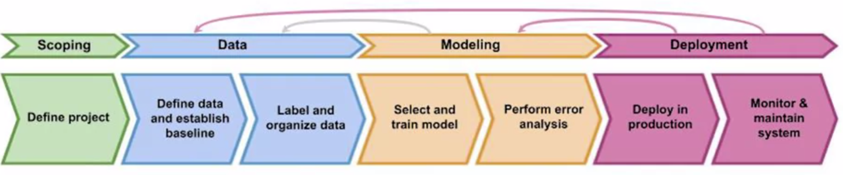
Introduction to MLOps
MLOps (Machine Learning Operations) is a set of practises for collaboration and communication between data scientists and operations professionals that aims to deploy and maintain Machine Learning models in production reliably and efficiently
Notes:
Ok. Lets now talk about MLOps. MLOps is .. (read it)
It a combination between ML and DevOPs

Slide 12
What is the course about?
This is not a Machine Learning (ML) Course
What we will learn:
You have trained a model, now what?
How to build and deploy Production ML Systems
Learn the full ML life cycle
How to evaluate your model
Difference between online predictions and batch predictions
How to choose between cloud & edge for serving
…
What we will not learn:
What is Artificial intelligence
Theory behind ML models
How to train a ML model?
Computer Systems
LLMs (but we will talk of them)

Slide 13
Prerequisites
Python (Basic Python 🐍)
Basic Understanding of Machine Learning concepts
Some understanding of Computer Systems.
There is a small review ML and some examples :)
I can also offer further help to any of these!

Slide 14
Grading
The final grade will be based on the following
60% Oral Exam
40% Project
There are (optional) questionnaires
There are also ML exercises
Exam will be in the form of discussion
Assignment topic is a simple deployment of an ML App.

Slide 15
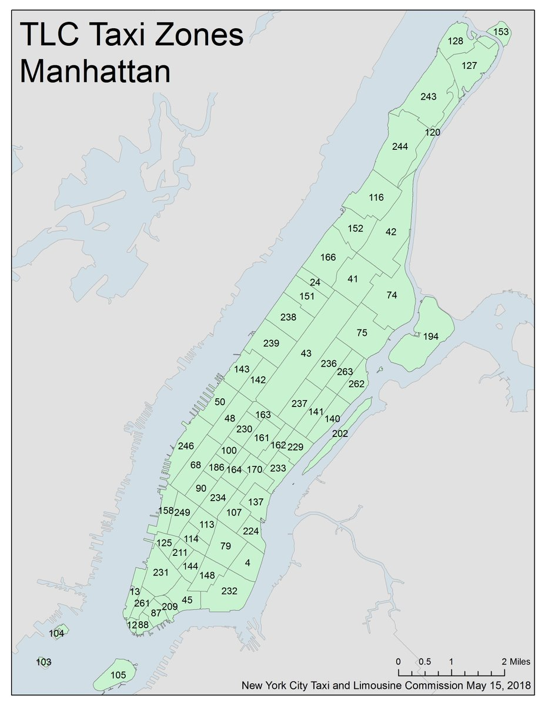

Potential Exam topic
You work with Uber.
Your task is design an ML-Based app that predicts the number of taxi rides in Manhattan
Every next hour
For each taxi zone
Avoid technical details (model selection etc)
Try to come-up with a good system design.

Slide 16
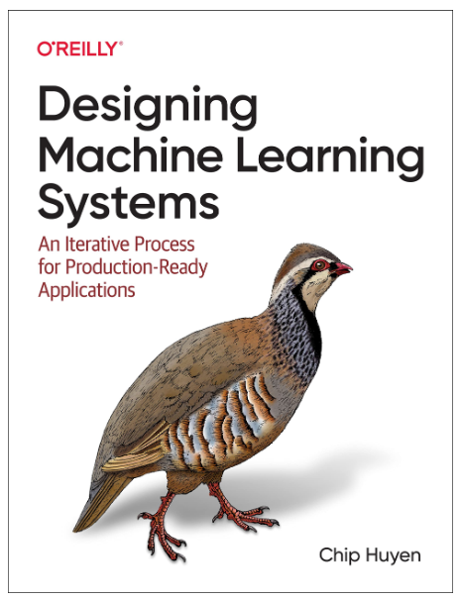
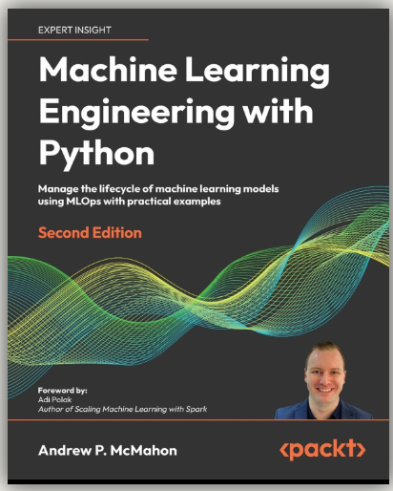
Resources
Designing Machine Learning Systems by Chip Huyen
Machine Learning Engineering with Python by Andrew P. MacMahon
deeplearning.ai : Machine Learning for production (MLOps) specialization
neptune.ai: MLOps: What it is, Why it Matters, and How to Implement it?
https://madewithml.com/
Stanford CS 329S: Machine Learning Systems Design

Slide 17




Software we will talk about
Python🐍
Compatibility with MLOps Tools
Wide range of libraries for every task at hand
Strong community support
Tools:
git
docker
fastAPI
Google Cloud
AWS

Slide 18
Example!!

Slide 19

Deployment Example
Use computer vision on a production line to inspect if phones have defects
Photo from a camera

Slide 20
Deployment Example
Use computer vision on a production line to inspect if phones have defects
Detect scratches
Photo from a camera

Slide 21
Deployment Example
Use computer vision on a production line to inspect if phones have defects
Detect scratches
Add a boundary box
Photo from a camera

Slide 22
Deployment Example
Use computer vision on a production line to inspect if phones have defects
Detect scratches
Add a boundary box
How do you use this model in production?
Photo from a camera

Slide 23




Deployment Example
Use computer vision on a production line to inspect if phones have defects
Detect scratches
Add a boundary box
How do you use this model in production?
Cloud server
Edge Device
Inspection Software
3
API
2
1
Prediction
Server
Camera
4
Control Software
Predict
ML model: F(X) => Y
5
Photo from a camera

Slide 24
Deployment Example
A complete ML system
Use computer vision on a production line to inspect if phones have defects
Detect scratches
Add a boundary box
How do you use this model in production?
Cloud server
Edge Device
Inspection Software
3
API
2
1
Prediction
Server
Camera
4
Control Software
Predict
ML model: F(X) => Y
5
Photo from a camera

Slide 25

Visual inspection example
MLOps has a continuous lifecycle
Trained a detection algorithm with 98% accuracy

Slide 26
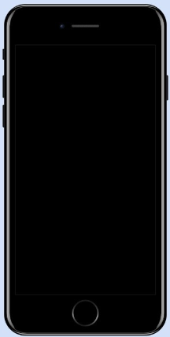
Visual inspection example
MLOps has a continuous lifecycle
Trained a detection algorithm with 98% accuracy
Change of light bulbs in the factory lead to lighting differences
New photos different than in the training set

Slide 27
Visual inspection example
MLOps has a continuous lifecycle
Accuracy drops to 65%
Trained a detection algorithm with 98% accuracy
Change of light bulbs in the factory lead to lighting differences
New photos different than in the training set

Slide 28
Visual inspection example
MLOps has a continuous lifecycle
Accuracy drops to 65%
Trained a detection algorithm with 98% accuracy
Change of light bulbs in the factory lead to lighting differences
New photos different than in the training set
This is called Data Drift.
A very common problem in MLOps applications

Slide 29
ML in Production Code
ML Model Code:
Code for selecting, tuning and fitting a ML model.
ML Model Code
Notes:
Lets now investigate what ML in production is like.
This is the ML code, the code to train and make predictions with a good ML model.

Slide 30
ML in Production Code
ML Model Code:
Code for selecting, tuning and fitting a ML model.
ML Project code
ML Model Code
“POC to production gap”
Notes:
This is the POC to production gap.
The gap to take your ML model and put it into production

Slide 31
ML in Production Code
ML Model Code:
Code for selecting, tuning and fitting a ML model.
Proof of Concept (POC):
The development stage where the fitted model is tested on a controlled environment
(eg a Jupyter notebook)
ML Project code:
The code required to take the initial fitted model into deployment
ML Project code (90-95%)
ML Model Code
5%-10%
“POC to production gap”
Notes:
This is all the code you need to design a good ML application

Slide 32
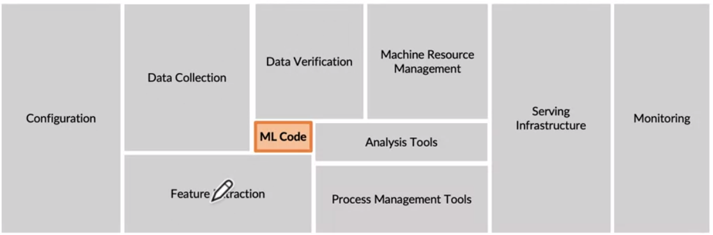
The requirements surrounding ML infrastructure
Requires the collaboration of different teams like Project Managers, Data Analysts, Data Engineers, Data scientists and ML engineers
D. Sculley et al NIPS 2015: Hidden Technical Dept in Machine Learning Systems
Notes:
Briefly describe each of these components

Slide 33
Two Myths about ML in Production
Deployment is hard
Machine learning can magically transform your business overnight
2020 state of enterprise machine learning (Algorithmia, 2020)

Slide 34
Two Myths about ML in Production
Deployment is hard
Deployment is easy, deploying reliably is hard
Machine learning can magically transform your business overnight
Magically: possible
Overnight: No
2020 state of enterprise machine learning (Algorithmia, 2020)

Slide 35
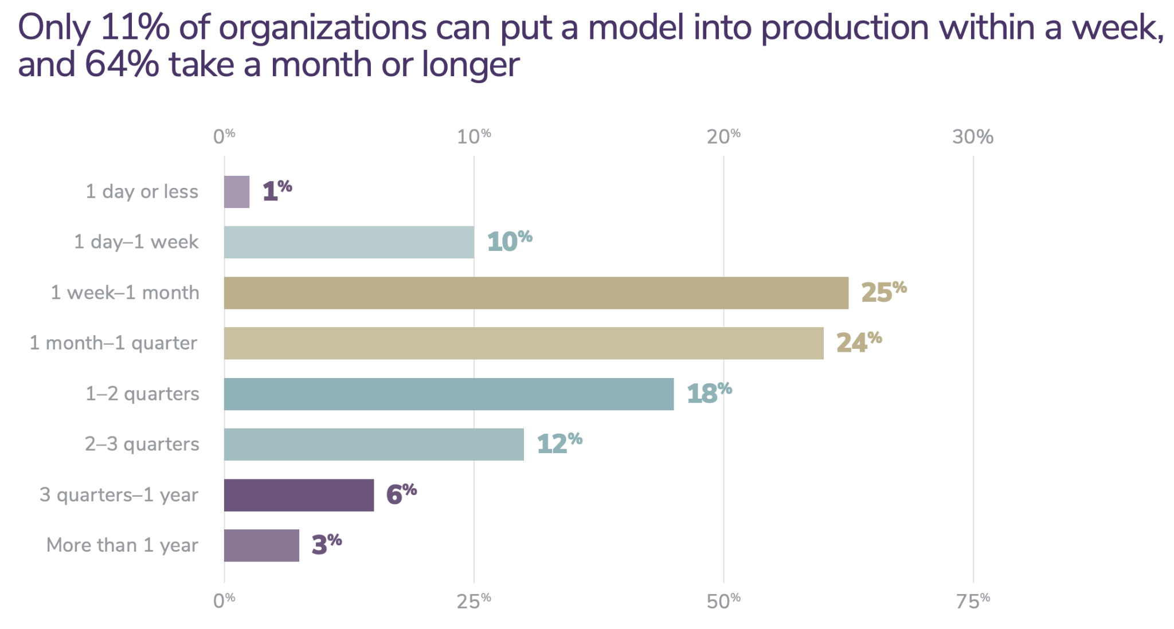
Two Myths about ML in Production
Deployment is hard
Deployment is easy, deploying reliably is hard
Machine learning can magically transform your business overnight
Magically: possible
Overnight: No
2020 state of enterprise machine learning (Algorithmia, 2020)

Slide 36
Summary
MLOps is the set of techniques that puts a machine learning model into production
It is a continuous and iterative cycle that includes but is not limited too:
Scoping
Data Collection
Modelling
Deployment
Maintenance
It includes a variety of potential pitfalls (like data drift) outside those being taught in Data Science courses.
Requires teams composed of different expertises.

Slide 38
Content of the Course

Slide 39
Material
12 Lectures -> Slides are all you need!
Hello World
Introduction to MLOps
Scoping
Introduction to Modelling
Modelling Part 2
Production Level Code
Example Session!
Introduction to Deployment
Deployment Technologies
Cloud Platforms 1.
Cloud Platforms 2.

Slide 40
Questionnaires
A total of 4 Questionnaires
Open questions -> some have no clear answer
Critical questions -> More value on how you justify your answer
Questions from real-world applications!
Will upload some more at the end of December!
Identical to exam questions.
Note: At the end of each lecture we will discuss some.

Slide 41
Exam
An open discussion!
Open - critical questions (similar to the questionnaire).
Definitions of important concepts.
I think of it more as a discussion.
You should think of it as an interview mock.

Slide 42
ML Exercises
Three exercises on how to build production level code!
Designed to improve your (production-level) coding skills
Optional
Each exercise contributes to your final grade
0.5 per completed exercise!
Note: Feel free to email me if you have questions on some of the questions!

Slide 43
Assignment

Slide 44
Practical Outcomes
Design and model an end-to-end Machine Learning application
Suitable for your CV
Understand the difference between project-level and production-level
How to structure and build the scope for a business problem
How to solve a structured application
How to design the deployment plan

Slide 45
Assignment Description
Task: Build and deploy a Machine Learning System
How: Follow the entire ML Lifecycle
Pick a Project.
Scoping: Clearly define your solutions.
Data: Identify data sources and gather your data.
Modeling: Develop a (simple) ML algorithm.
Design the framework to deploy your application.

Slide 46
General Assignment Description
General Task:
Details:
Individual (or two-people team)
Subject is to be decided by the team (Always open to help!)
It should be ML-based (past project, Kaggle, anything you want to work on)
You can use a ML model developed on another project!
Teams can be formatted either by you, or I can randomly assign them!

Slide 47
Task 1: Scoping
Write a good project proposal!
Structure the project
Business goals
Metrics!
Clear instructions will be given in the Assignment description

Slide 48
Task 2: Model the Solution
Build a solution for your ML problem.
Compare models
Evaluate
Explain the final model selection
Note: The end-result (accuracy etc) does not matter for this task!
This is not a ML class. I want a solution, not a great solution!

Slide 49
Task 3: Deploy the Solution
Design the framework to deploy your solution.
Organize your package
Design the system architecture to deploy your model
Develop a mock of the end-interface
More details on the deployment courses.

Slide 50
Grading
Each task is graded individually!
final grade = grade 1 + grade 2 + grade 3
At least over 3/10 is required on each task.
Tasks will be given throughout the course.
We will discuss progress on 19th of December!
Deadline is early January 8 but it is flexible
Do not hesitate to contact me!

Slide 51
Questions, concerns, comments?

